Slide 1

CORPORATE FINANCE
IN EUROPE
BACKGROUND CFIE

Slide 2
Index CFIE
  This presentation contains the following items:
  Overview CFIE
  CFIE European network
  Team CFIE
  Industry Focus
  Direct contacts with Buyers
  Action Plan and Timing
  Valuation of companies
  Team closed projects

Slide 3

  Funded 2001
  High quality
  M&A services
  View of GAP in M&A services
  to mid sized
  SME’s
  CFIE’s European network of M&A experts uses a proven methodology to help you in the sale of your business.
  CFIE Starting points:
  Funded in 2001
  High quality M&A services
  View of GAP in M&A services to Mid Sized European SME’s
  Our client’s profile:
  20-400 employees
  2-100M Revenue
  2-50M Valuation
  Overview CFIE
  CFIE Key Differentiators:
  Various Industry experts
  Languages (local language)
  Good direct contacts to buyers
  Leveraging an European network
  Integrated and connected M&A network
  CFIE objectives:
  Help business owners sell
  Create liquidity (cash) for business owners
  Make European M&A market more efficient

Slide 4
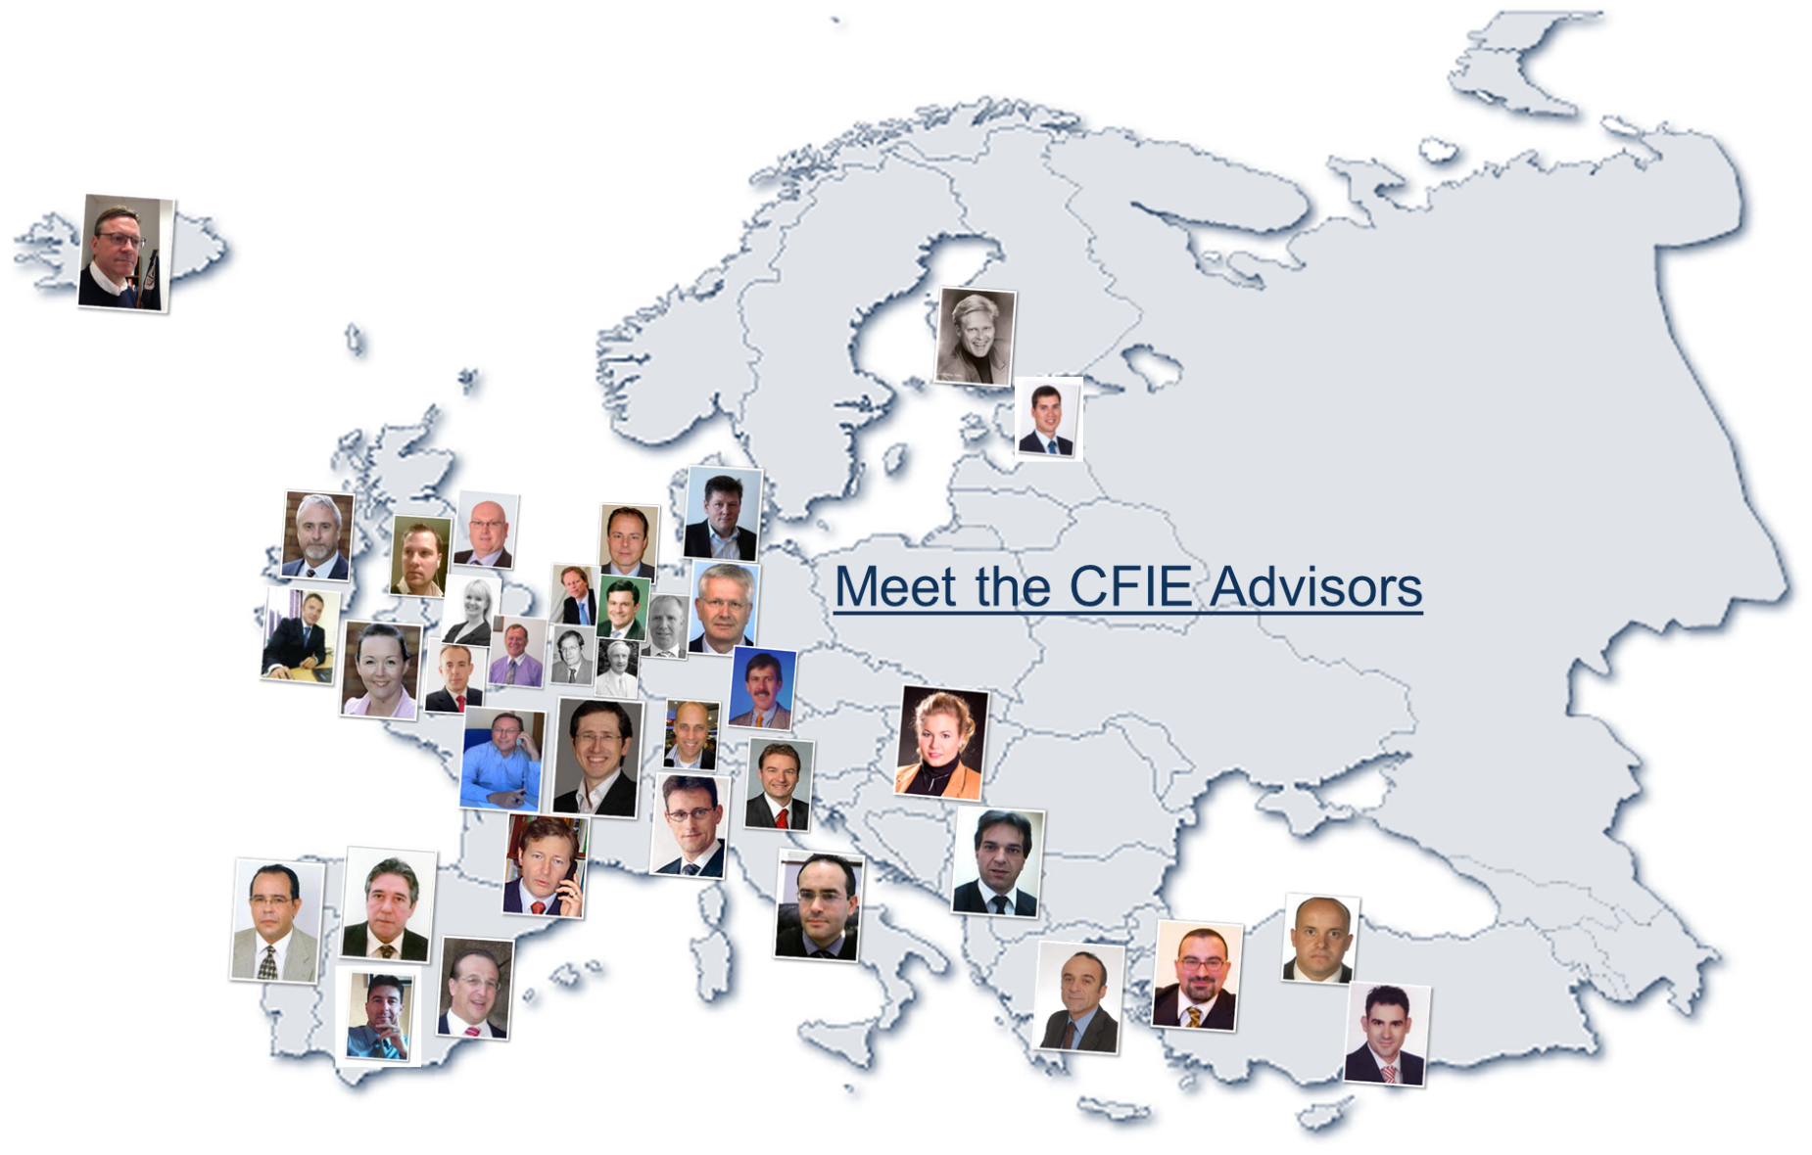
  CFIE’ s European M&A Team

Slide 5
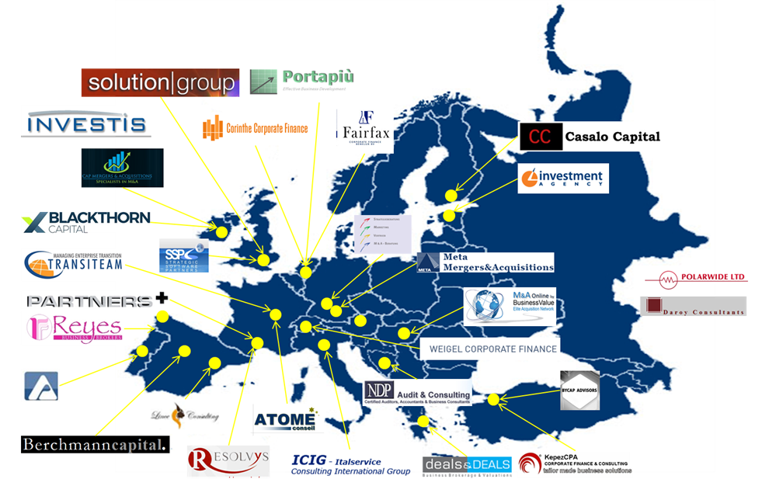
  CFIE’ s country offices

Slide 6




  CFIE’ s European Team
  Govert Derks (Netherlands):
  Finding suited cross border buyers
  Finance background with General Electric
  Language skills (SP, GE, UK, FR)
  Winfried Weigel (Switzerland):
  Renewables & Cleantech expert
  Ex UBS & JP Morgan
  Engineering graduate and MBA
  Mark Hardwicke (United Kingdom):
  Mid sized deal expert
  Engineering, biotech & media
  Accounting background
  Alain de Vera (France):
  M&A advisory services
  Ex Apple, DEC, Sequent
  MBA Marketing and Political Sciences, History studies

Slide 7




  CFIE’ s European Team
  Wolfgang Braun (Germany):
  Strong IT industry experience
  M&A skills gained via various acquisitions
  Computer Science and MBA
  Adalberto Barbosa (Portugal)
  Transportation and logistics background
  Experience with M&A in Portugal
  Finance and Investments, Business Administration
  Pekka Salo (Finland)
  Specialist in SME M&A in Finland
  Strong legal background
  Business law and MBA
  Eugenio Ciscar (Spain):
  Financial Management (CFO)
  Textile, printing, transportation
  Business Administration

Slide 8




  CFIE’ s European Team
  Massimiliano Pifferi (Italy):
  Tax background and legal structuring
  Ex Deloitte and KPMG tax
  Corporate and International/EU Tax Law
  Barkan Baybogan (Turkey):
  Turkish M&A specialist
  Financial services, Manufacturing
  J&W University Economics
  Carl Pitchford (Belgium):
  Furniture industry expert
  Business sales of furniture manufacturers
  Certified Internal Auditor
  Antoine Moser (Netherlands):
  International BD and M&A
  CRM, Outsourcing & Call Centre
  Msc. Civil Engineering, MBA (IMD)

Slide 9




  CFIE’ s European Team
  Vladimir Dabic (Serbia)
  Focus on M&A in Serbia
  Capital valuation, M&A, legal
  Industrial management, Certified Broker on the BSE
  Ann-Marie Reddy (Ireland)
  Specialist in M&A in Ireland
  Financial due diligence expert
  Certified Public Accountant
  Michiel Segers (Netherlands)
  Expert in building and construction
  M&A focus on the Netherlands
  Business Economics
  Mehmet Kepez (Turkey)
  M&A for Turkish businesses
  Firm Valuations and Distress Management
  Applied Economics, Finance

Slide 10




  CFIE’ s European Team
  Christos Roussis (Greece)
  Buying and Selling medium-sized Greek businesses
  Company & Business Valuations
  M.Sc. in Economic Sciences
  Francois Gaudry (France)
  Business sales for medium sized manufacturing companies in France
  masters of law at La Sorbonne
  Celestino G. Reyes (Spain)
  Business sales for SME’s in Galicia (North-West of Spain)
  Business and General Economics
  Necip Uludag (Turkey)
  Direct Private Equity access
  IPO expert for Turkey
  Growth financing for medium sized Turkish businesses

Slide 11




  CFIE’ s European Team
  Haukur Thor Hauksson (Iceland)
  M&A expert for Island
  Financial services and retail
  London school of economics
  John Corcoran (Ireland)
  Focus on M&A for SME’s in Ireland
  Food and Healthcare experience
  Legal background
  Katalin Ballun (Hungaria)
  Business sales in Hungary (family businesses)
  Valuation and presentation services
  Corporate Finance degree
  Erki Katkosild (Estonia)
  Focus on M&A in Estonia
  Baltic commercial real estate market
  Estonian Business School

Slide 12
Industry Focus CFIE
  Renewables / Clean tech
    Solar
    Wind
    Bio fuels
    Energy efficiency
  Plastics
    Raw material manufacturers
    Plastic injection moulding
    Household and kitchen plastic goods
    Software (ERP) industry providers
  Industry specialization specific strategy CFIE
  Other industries
    Cosmetics
    Pharmaceuticals
    Life sciences
    Manufacturing
  Other industries
    Cement
    Call Centers
    Forest and paper
    HR Outsourcing

Slide 13
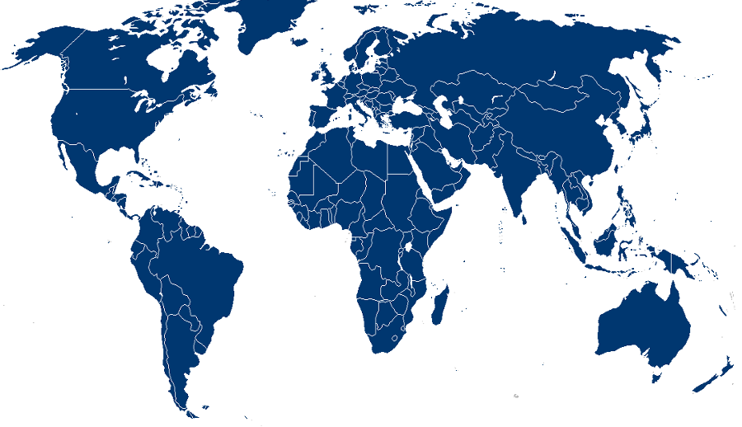



















Direct contacts with buyers in various industries (eg IT)
Europe
Asia
Americas

Slide 14
Action Plan & Timing
STEP 1:
INITIAL DISCUSSION
STEP 8: 30-60 Days
CLOSING
deal
1
STEP 2: 10-30 Days
CFIE REVIEWS COMPANY
FINANCIAL INFORMATION
2
7
3
STEP 7: 30-60 Days
NEGOTIATION
STEP 3:
EXECUTE ENGAGEMENT
AGREEMENT
6
4
5
STEP 6: 30-90 Days
FACILITATION OF
INFORMATION EXCHANGE
STEP 4: 30 Days
PRE-SALE PLANNING
STEP 5: 30-60 Days
MARKETING OUTREACH

Slide 15
Valuation of Companies
Fair Market Value
Depth of Management
Strength of Revenue & Profitability
Proprietary Products / Services
History / Future
Distribution Channels
Customer Agreements
  The true valuation is determined by the price in the market. A price where a willing seller and buyer agree on.
  CFIE can prepare detailed valuation models (science) , but well positioning (art) is also important. The objective is to find the buyers that appreciates your profile
  Bring more (international) buyers in a guided process and ask for proposals to maximize actual bids and valuation
Market and clear positioning will determine Final Value
Notes:
14

Slide 16
HIRE A CFIE ADVISOR
We speak your (local) language
Deep knowledge of your industry (European buyers)
We know how to get the deal done
Are part of an European network for one stop M&A
Ask for our references!!

Slide 17
Some Team projects closings

Slide 18
Some Team projects closings

Slide 19
Some Team projects closings

Slide 20
Some Team projects closings

